Slide 1
Application to access Student registration Database
By Sagar S Patil

Slide 2
Overview of the Project
I have made use of Java Swing and window builder for this project. It consists of two frames.
1). Login- Where I authenticate the user.
2).Userinfo- Where I have created the dashboard like frame which consists of various buttons from which the user can retrieve the data from the database.
Note:I have created dbConnector() method in postgresConnection.java to make connection to the postgres database.

Slide 3
Connecting to postgres database
I have made use of the postgresql driver(postgressql-42.3.4.jar) and then formed the JDBC url using the details of the database then formed the connection.
I have implemented this in postgresConnection.java
In Login.java and UserInfo.java I will just create a connection object and then call the dbconnector() to make the connection to the postgres database.

Slide 4
Login page
In the login frame the user is prompted to enter the username and database and I have fetched the username from the pg_user table and password I have decrypted the password from password field to string and then compared it with actual value.
Note: Since the password column in pg_user is encrypted , I have directly compared it with the hardcoded value.

Slide 5
University Related Data retrieval from Database
In total I have implemented 10 queries as mentioned from the problem statement.
I have made use of prepared statement which queries the database using the connection object and the result is stored in the result set. Then from the result set the data is being displayed to user using the Jtable and here I have made use of rs2xml.jar to make sure that data is displayed in proper format.

Slide 6
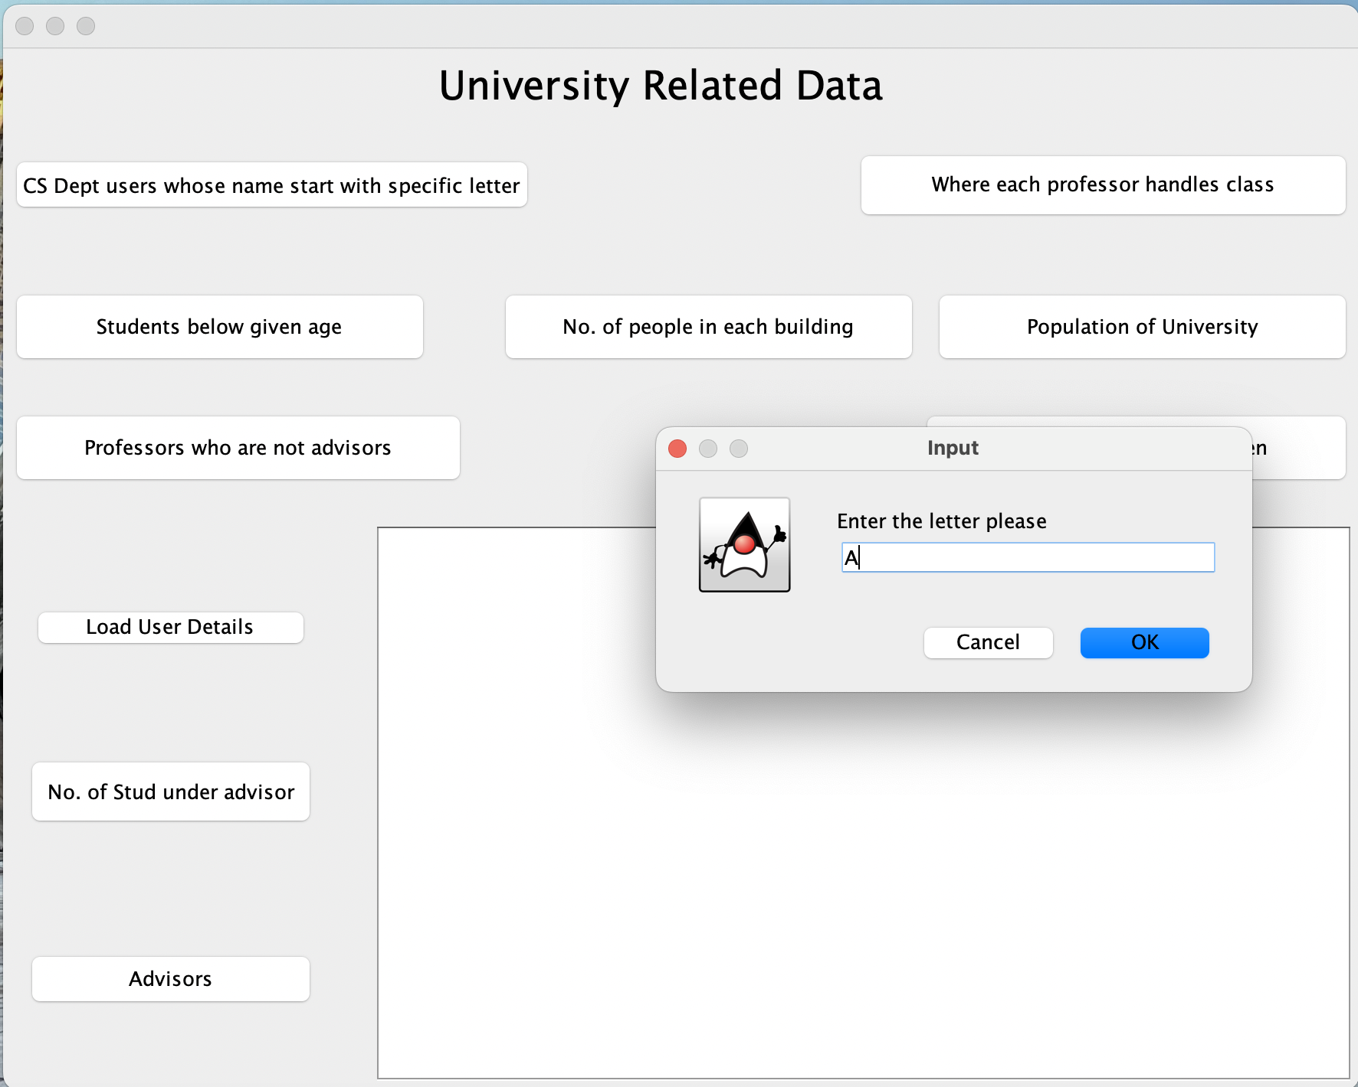
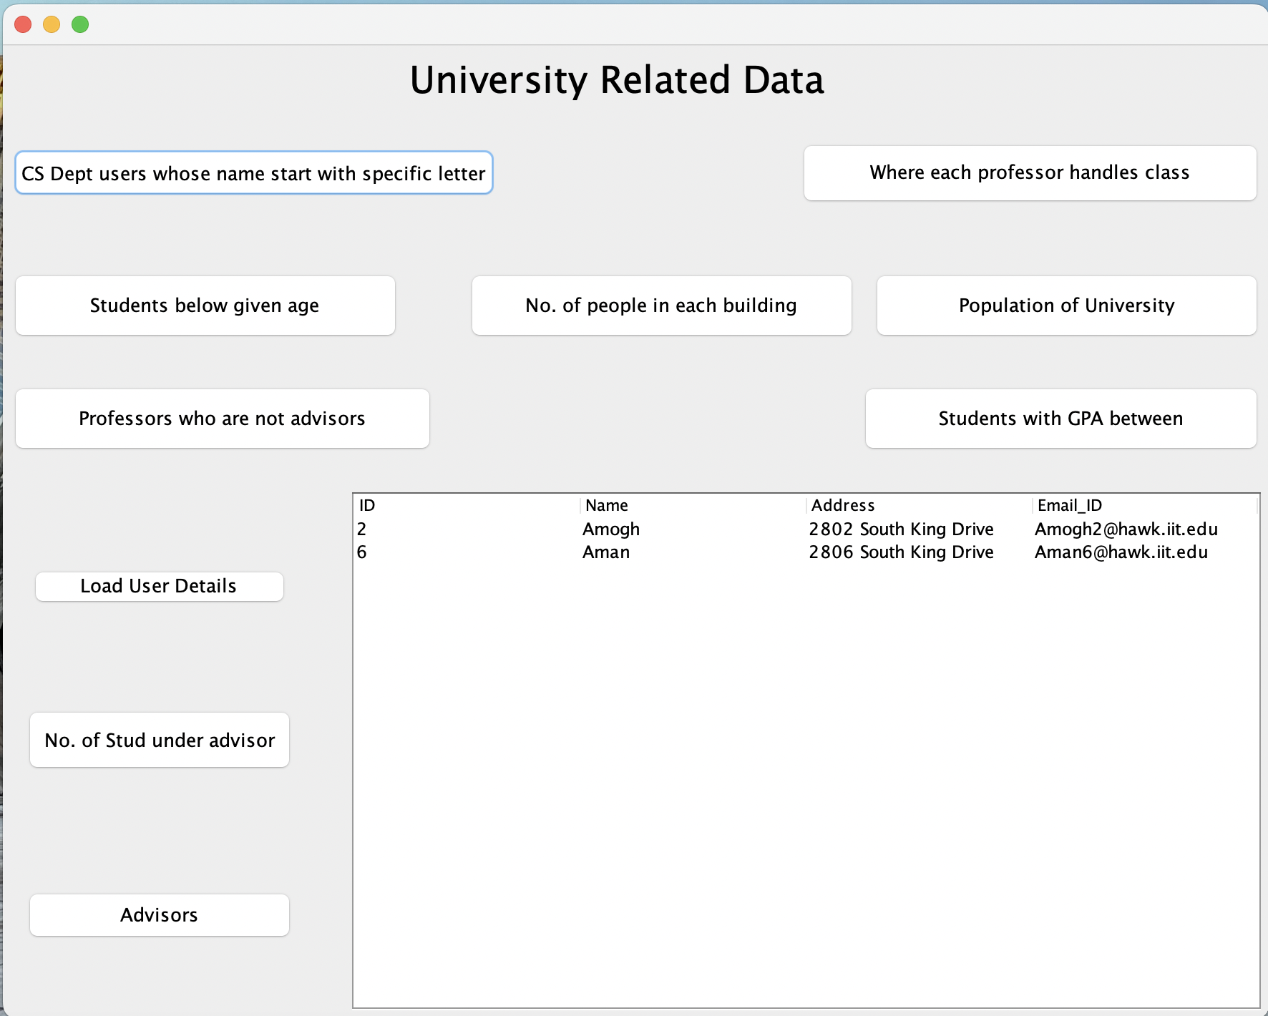
CS Department users whose name starts with specific letter

Slide 7
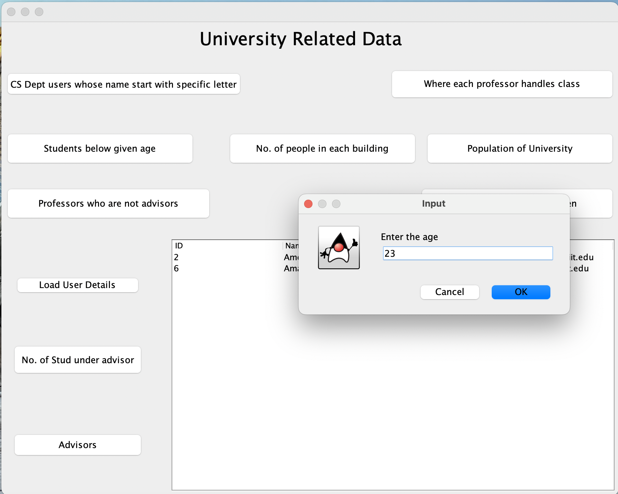
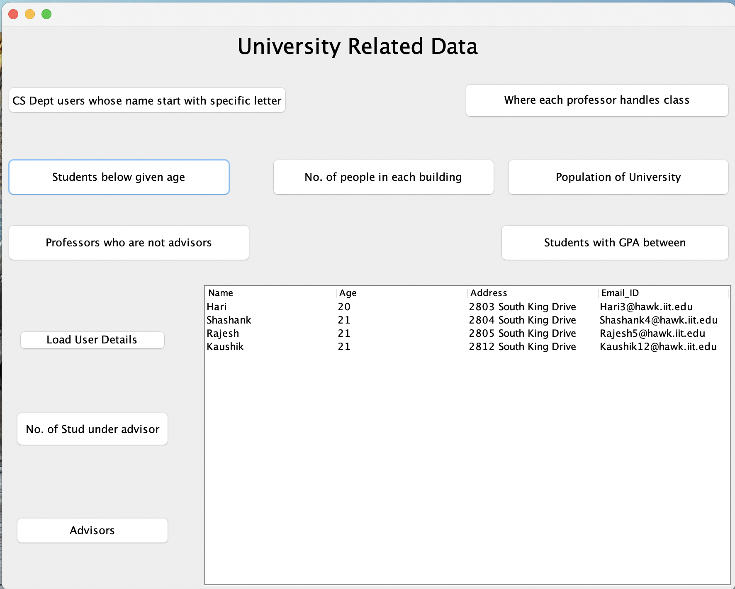
To find the details of the student below the age given by user

Slide 8
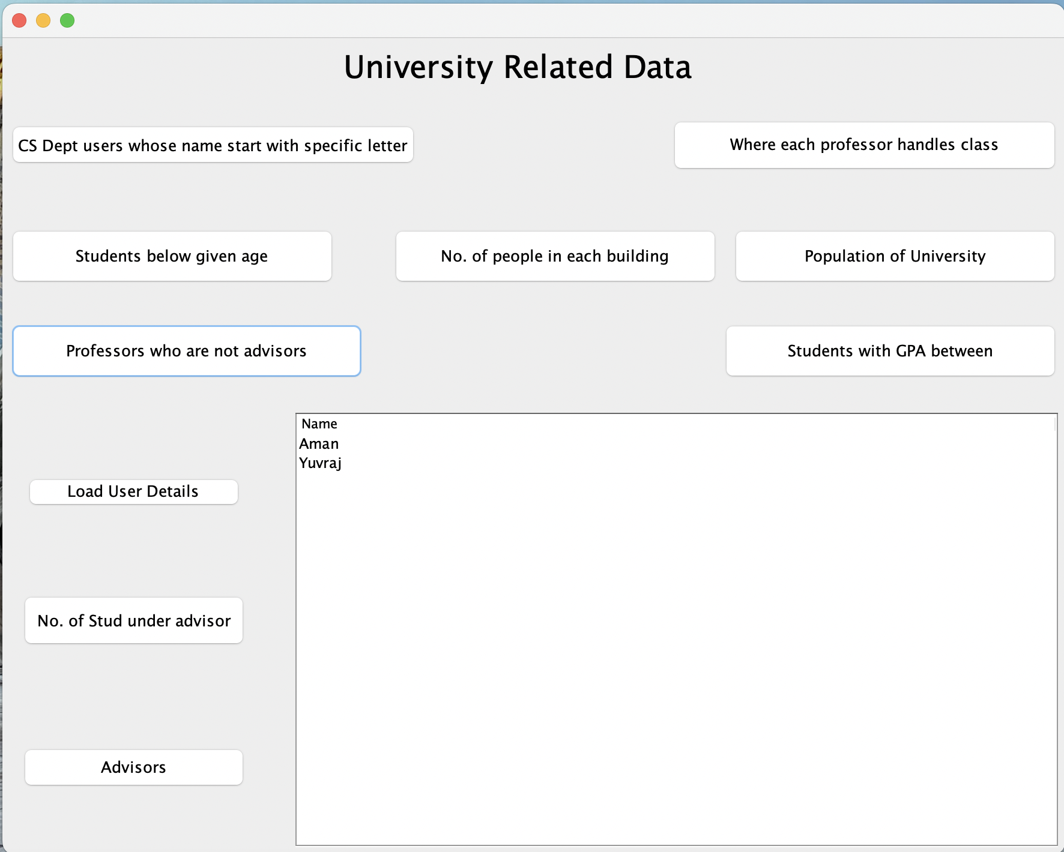
To find the professors who are not advisors

Slide 9
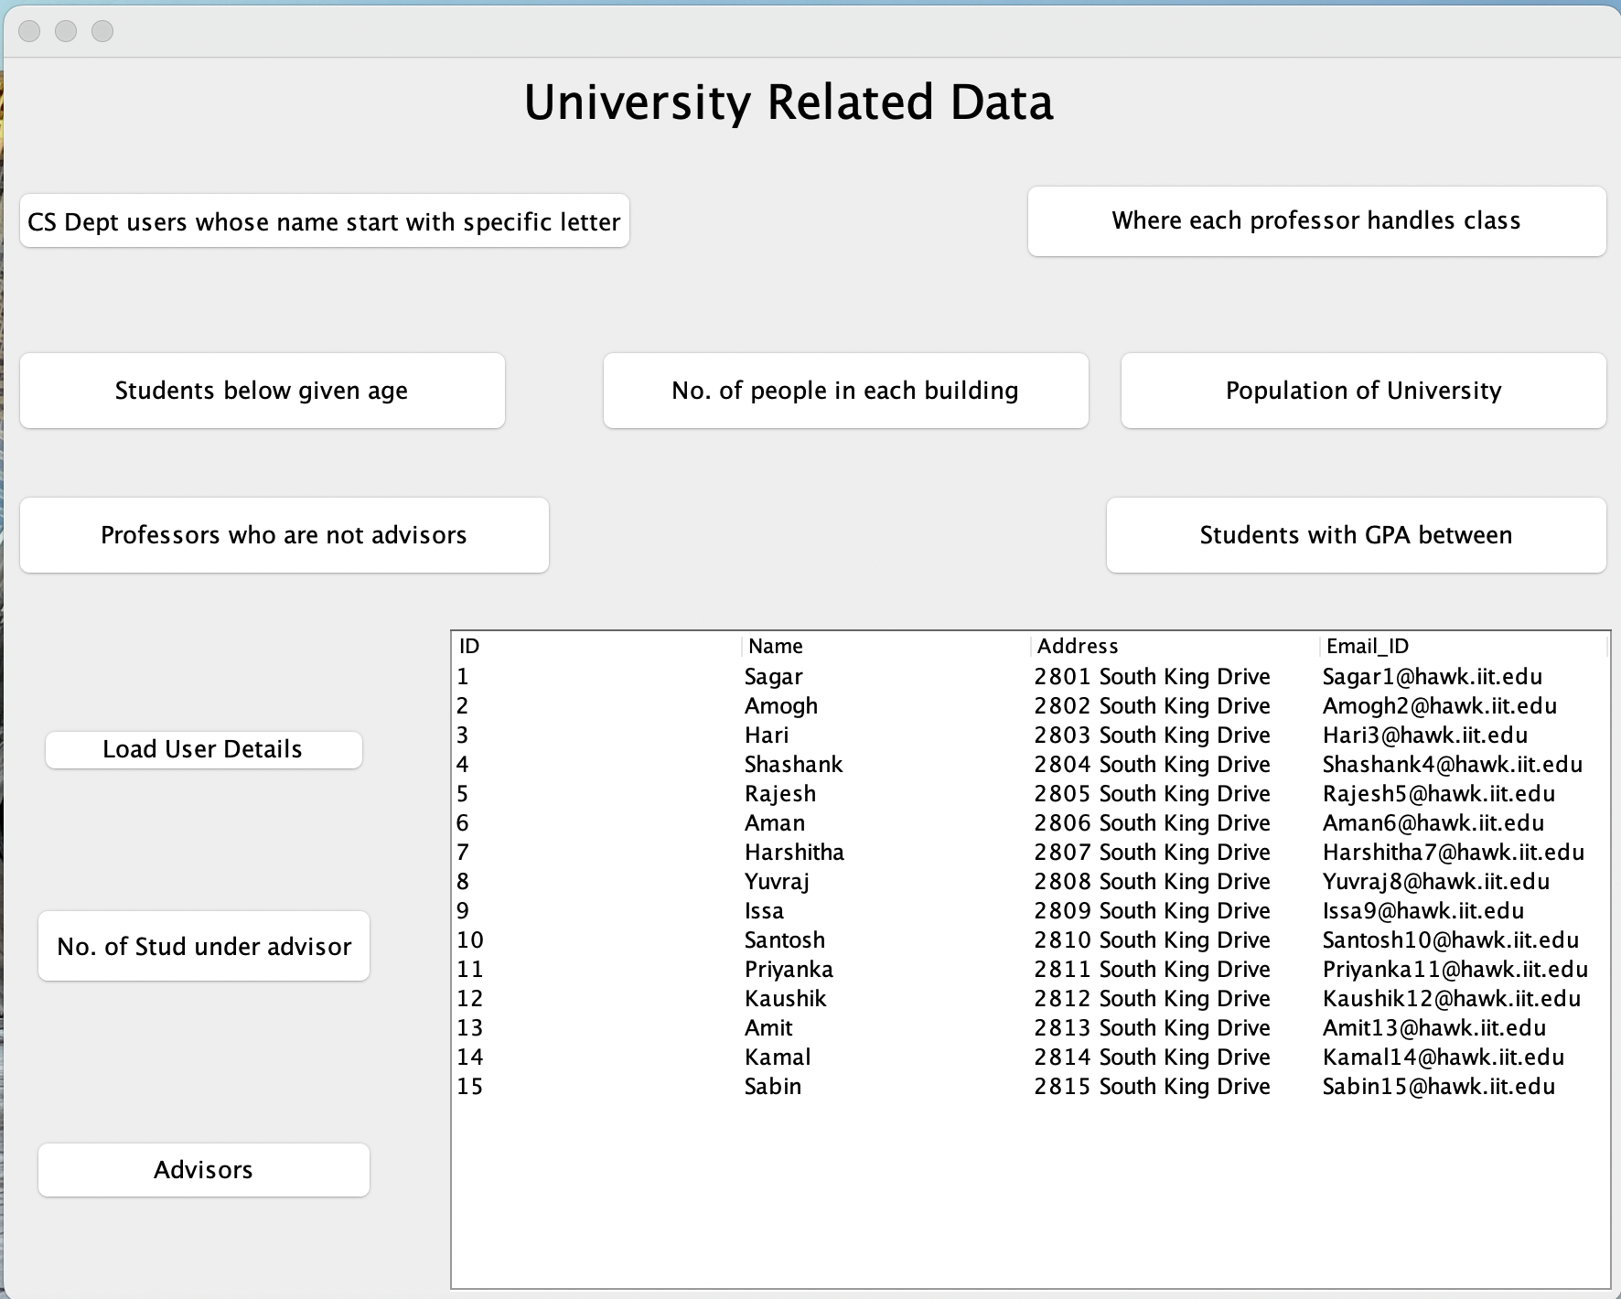
Loading the user details(Both Student and Professors)

Slide 10
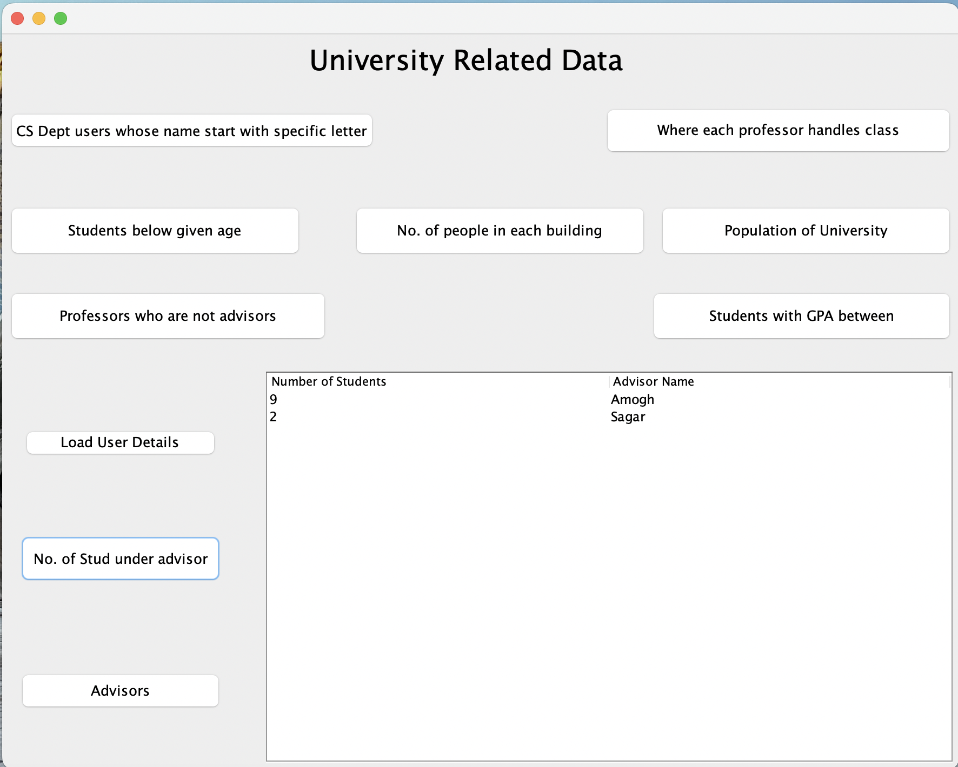
Number of Students under each advisor

Slide 11
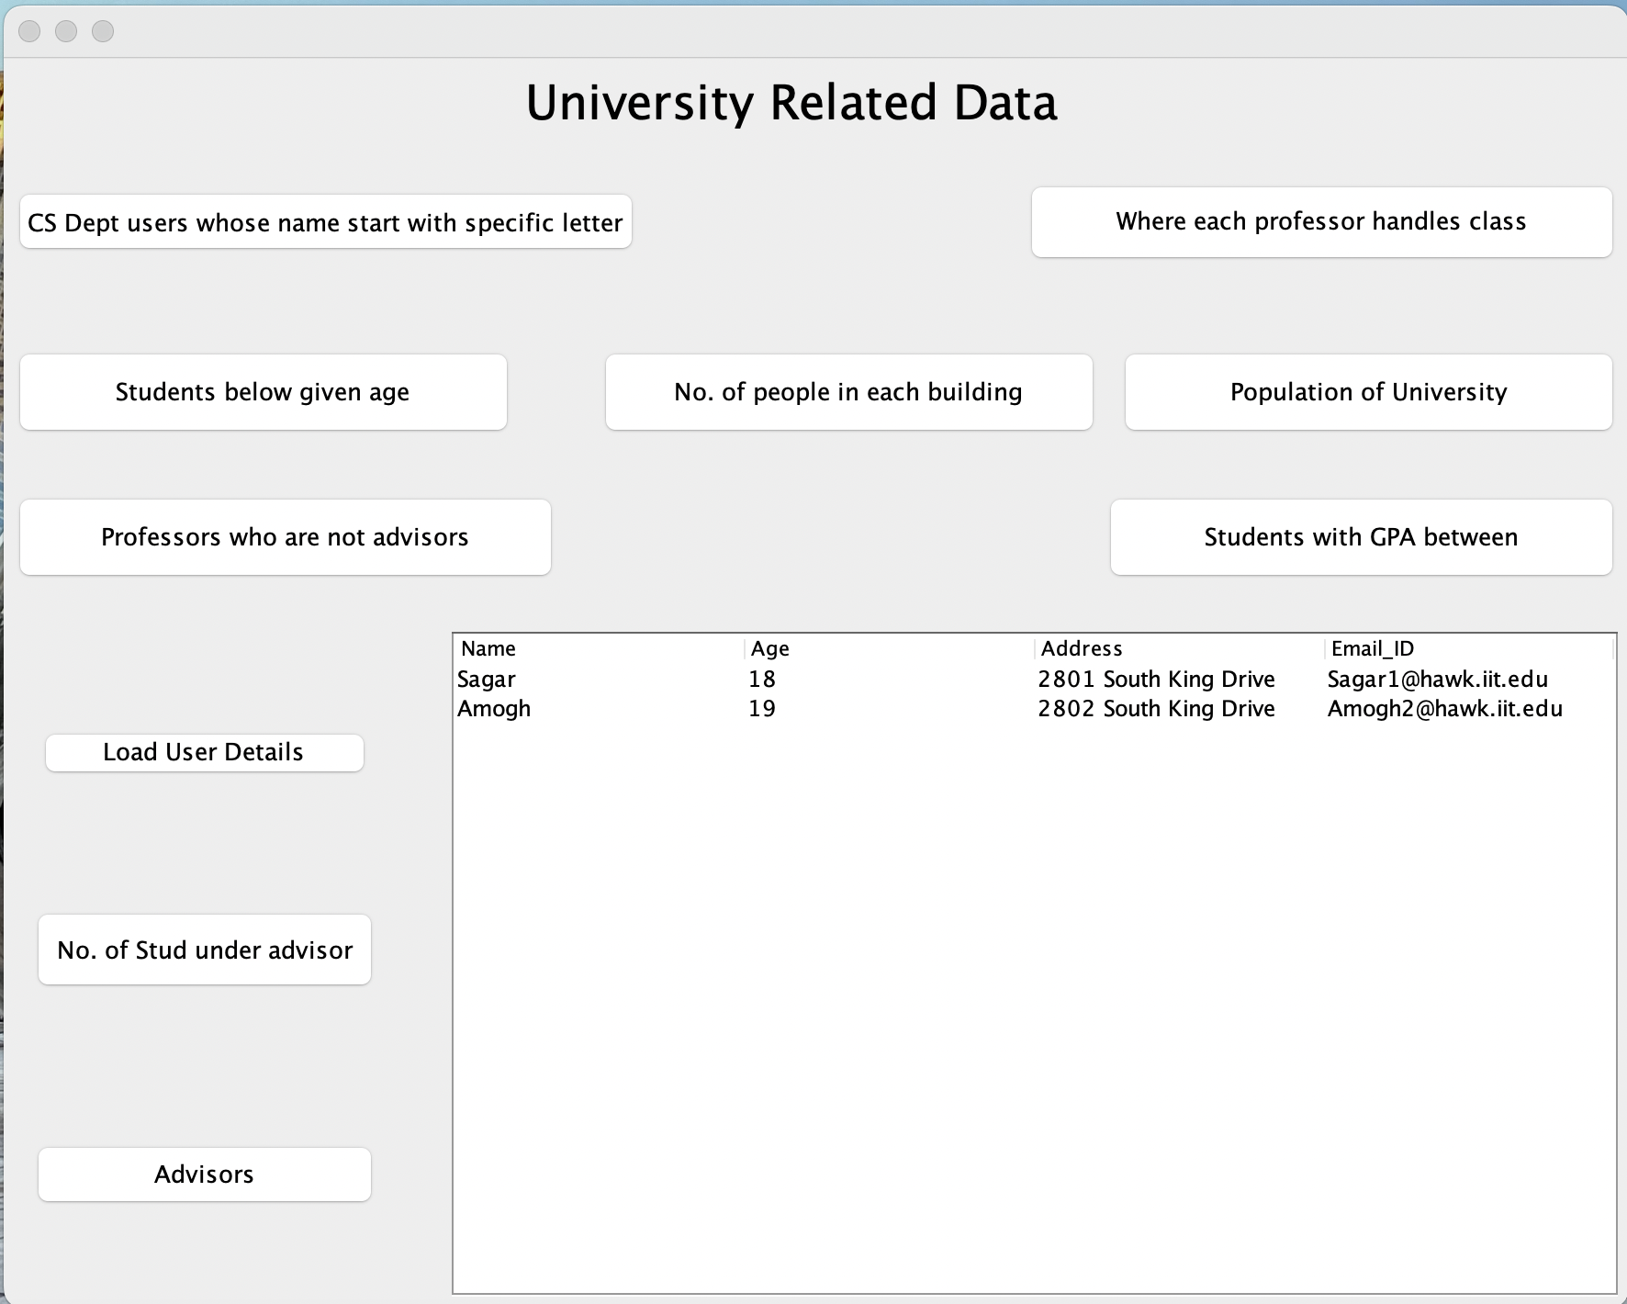
Details of the advisors

Slide 12
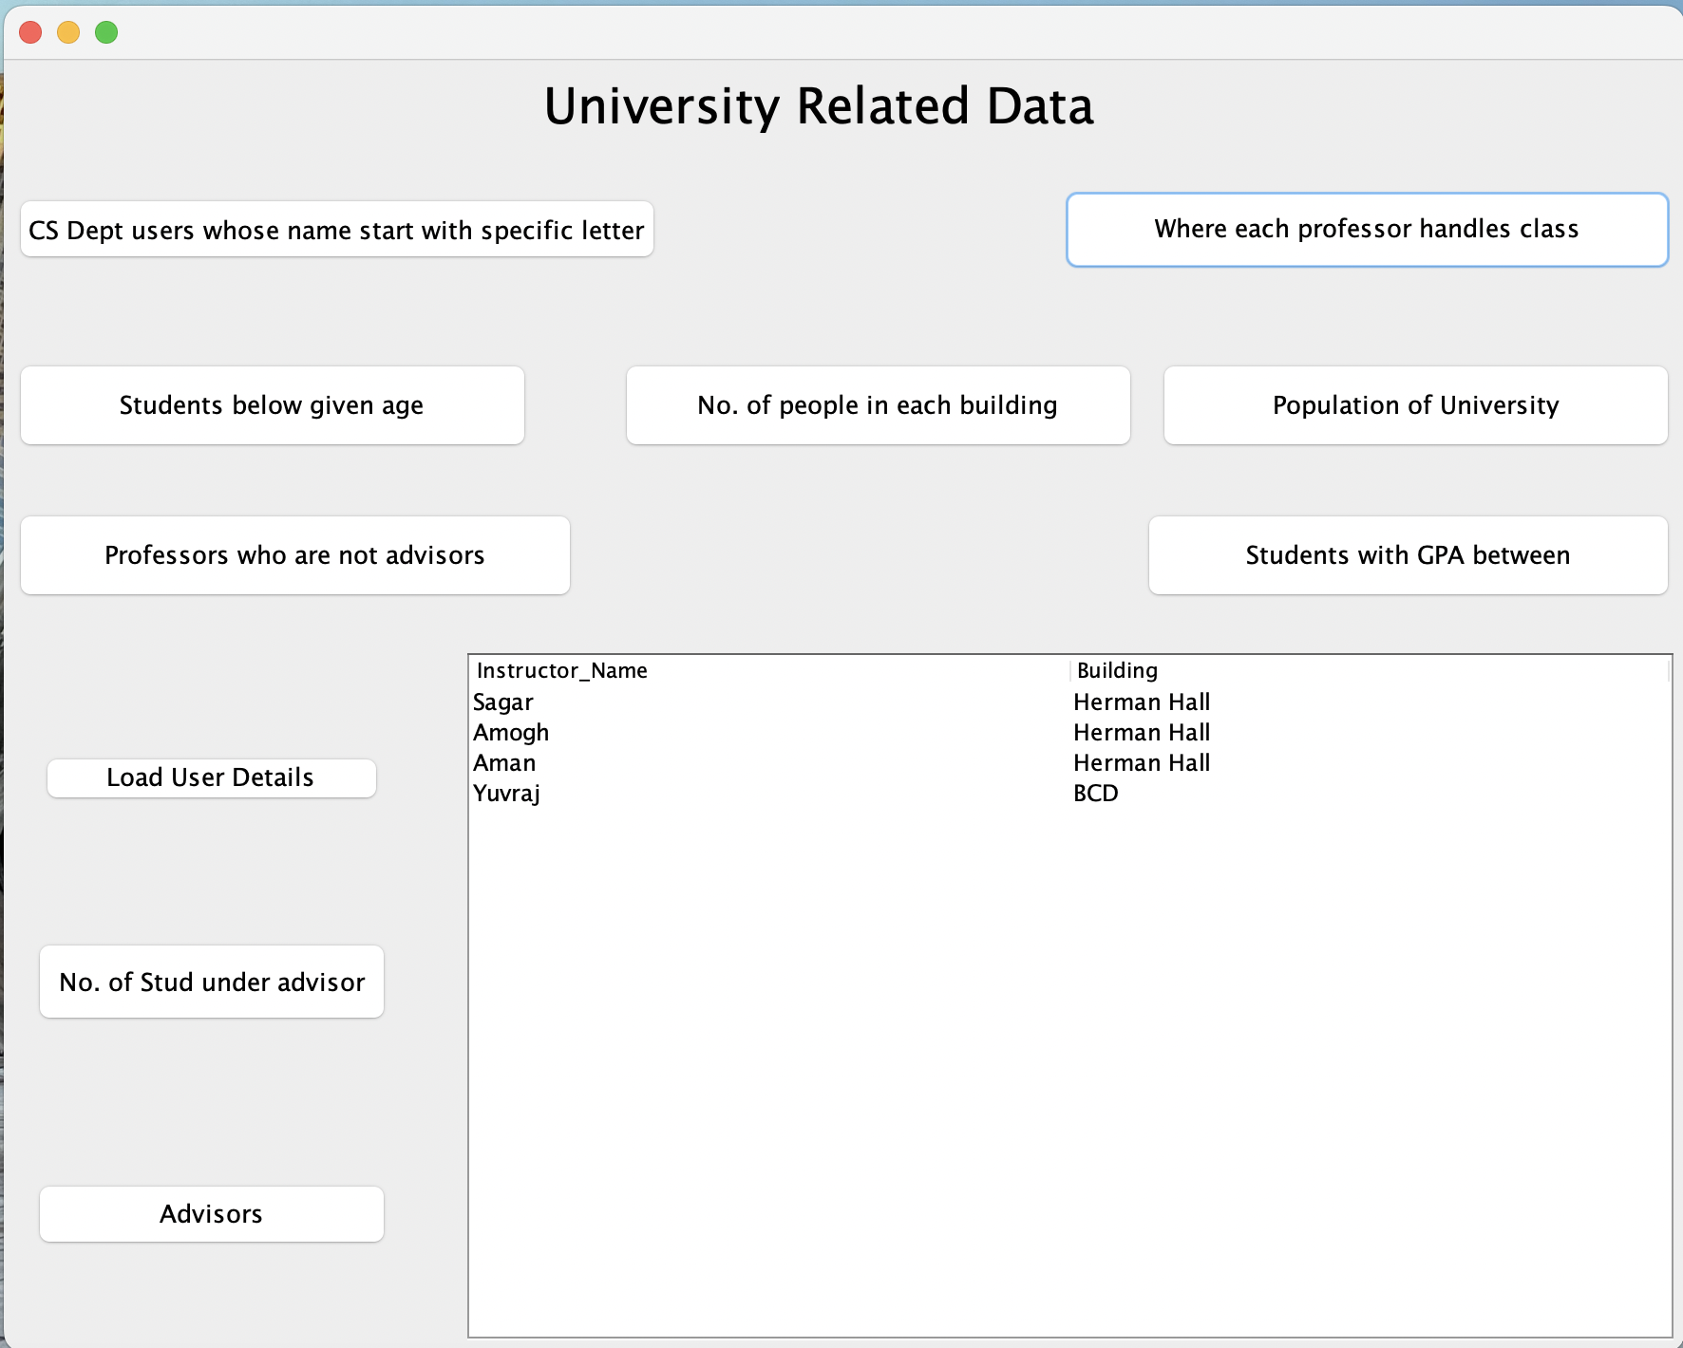
Building where the professor handles class

Slide 13
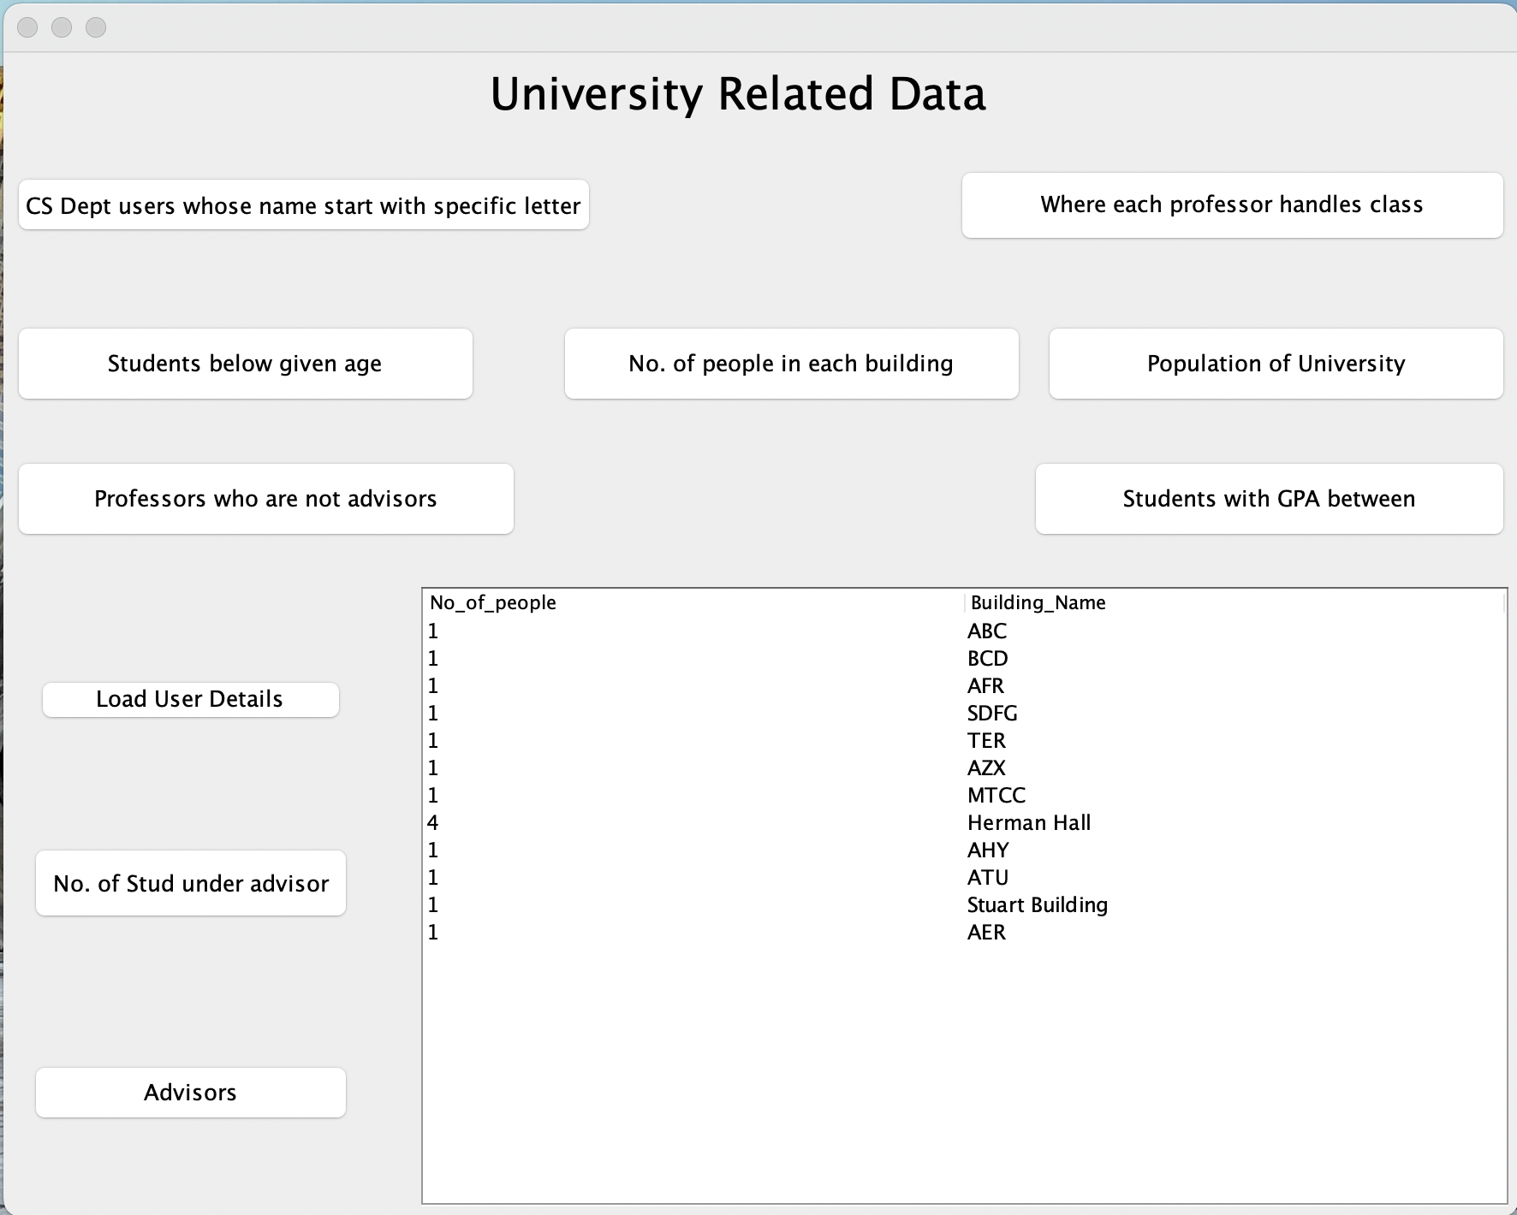
Number of people in each building

Slide 14
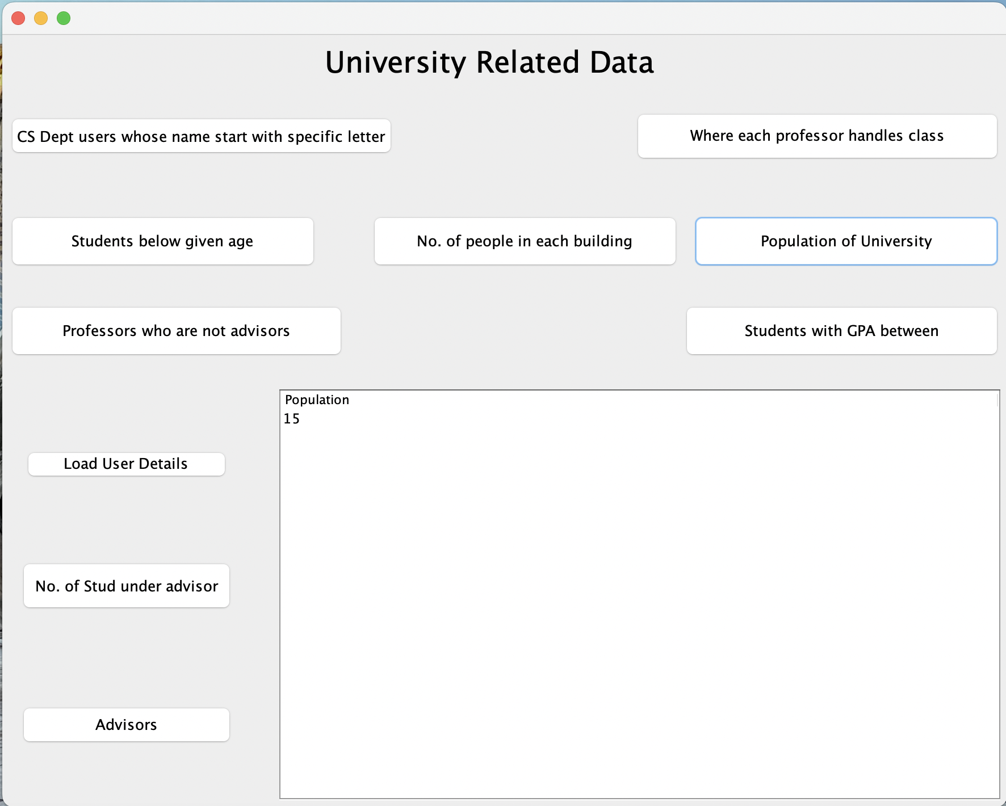
Total Population of the university

Slide 15
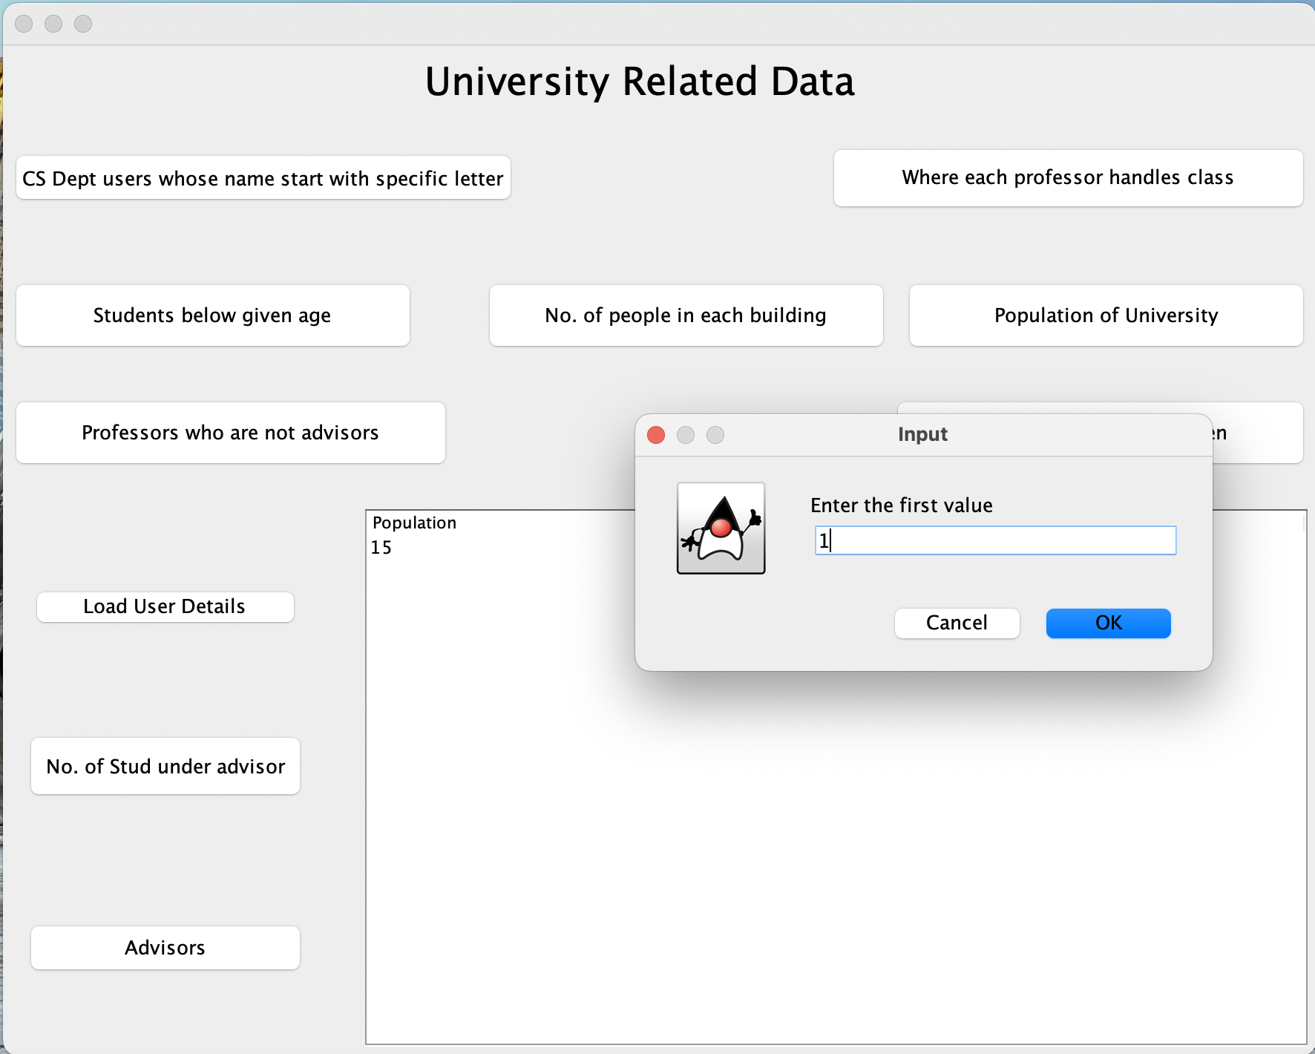

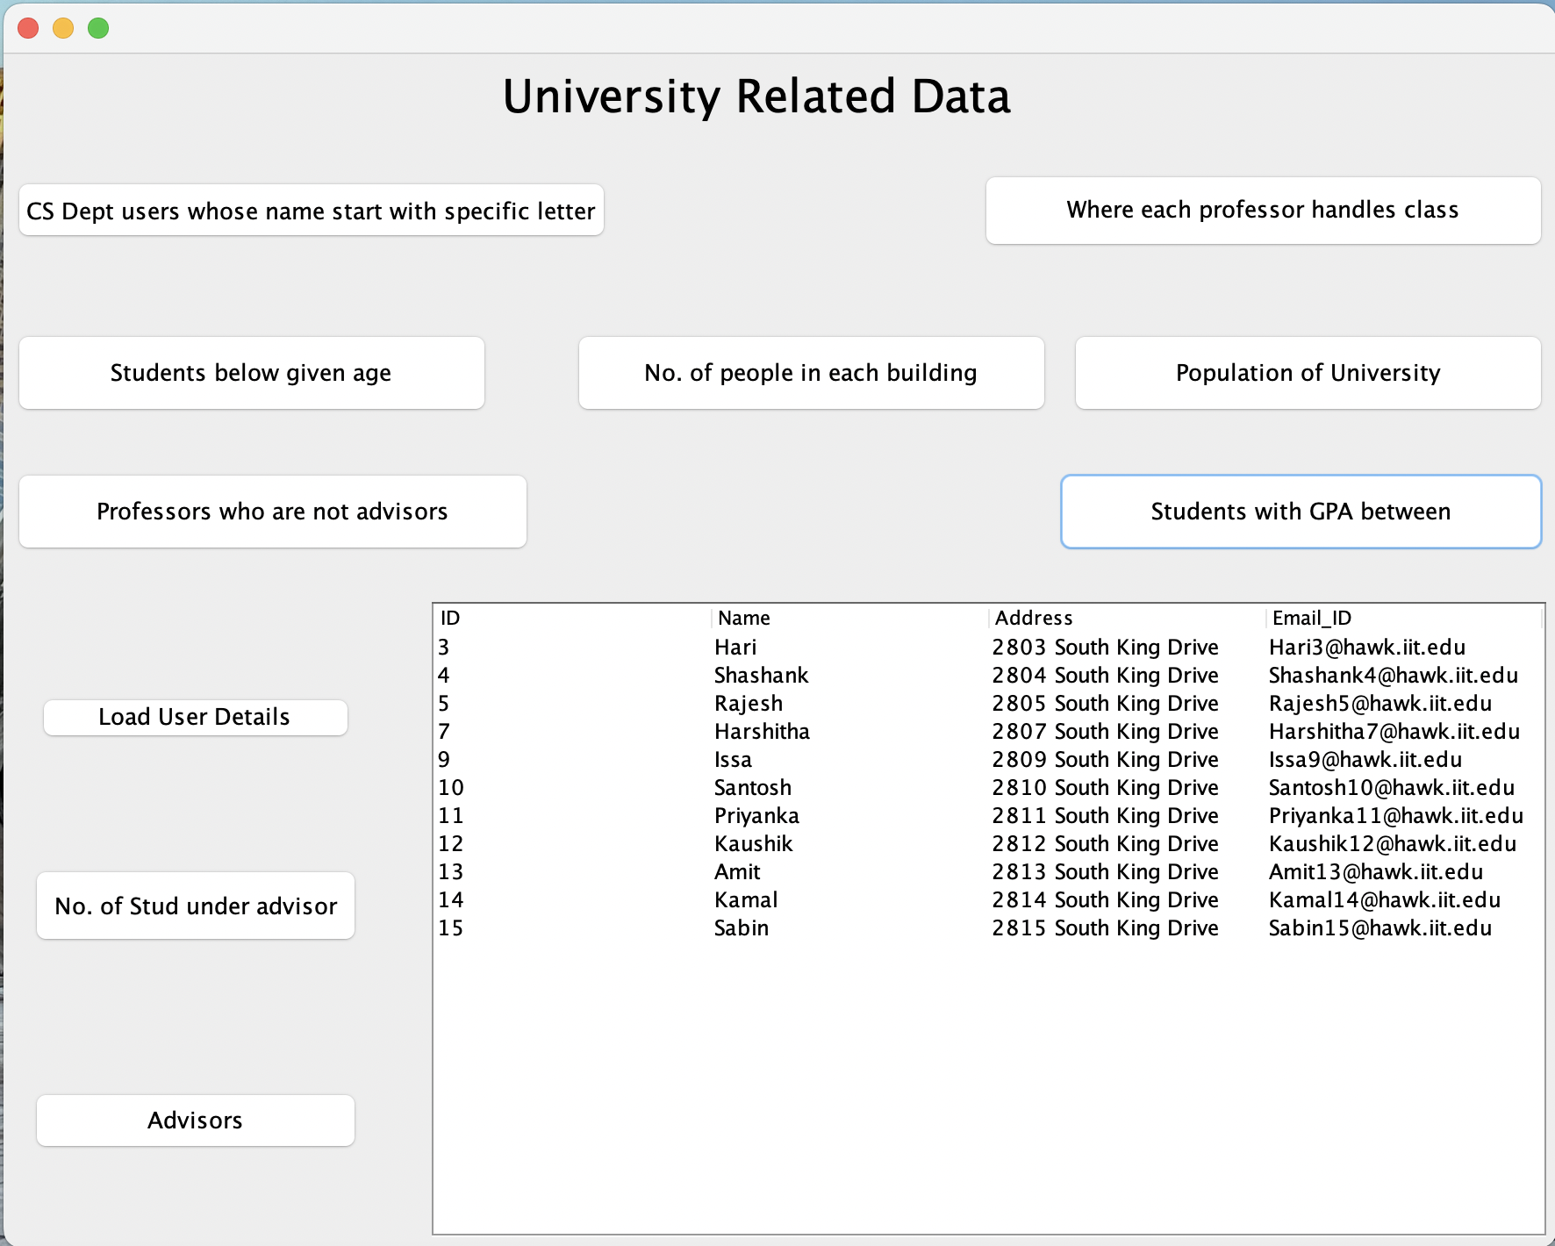
To find the details of the students whose GPA is between(two values)

